Slide 1
Recursion
Programming Club Akgec

Slide 2
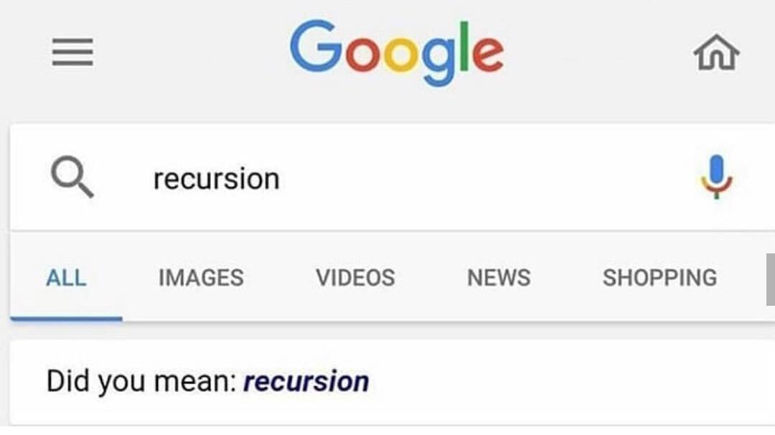

Slide 3
Recursion
1. The process in which a function calls itself directly or indirectly is called recursion and the corresponding function is called a recursive function. Using a recursive algorithm, certain problems can be solved quite easily.
2. The process of solving a problem by reducing it to smaller versions of itself is called recursion.

Slide 4
A. Given a number N. Print numbers from 1 to n in separate lines.
B. Given a number N. Print numbers from N to 1 in separate lines.
C. Given a number N and array A of N number. Print the number in even indices in a reversed order.

Slide 5
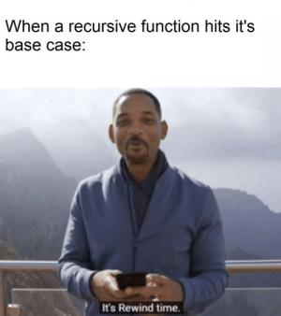

Slide 6
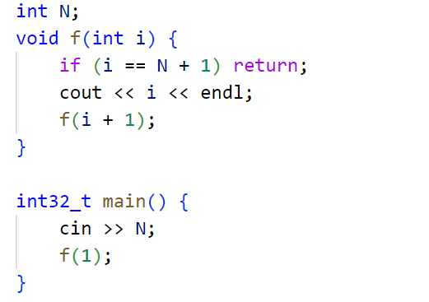
Solution A:

Slide 7
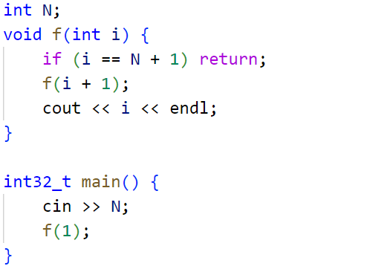
Solution B:

Slide 8
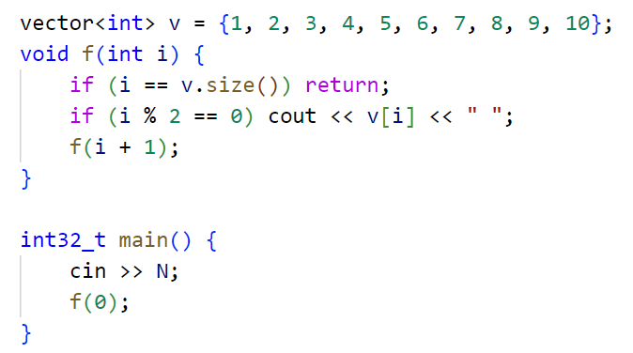
Solution B:

Slide 9
Factorial
5*fac(4)
4*fac(3)
3*fac(2)
2*fac(1)
fac(5)
fac(4)
fac(3)
fac(2)
fac(1)
120
24
6
2
1

Slide 10
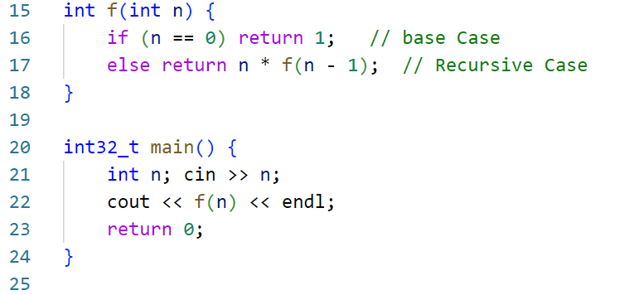
So we can write it as this

Slide 11
Fibonacci number

Slide 12
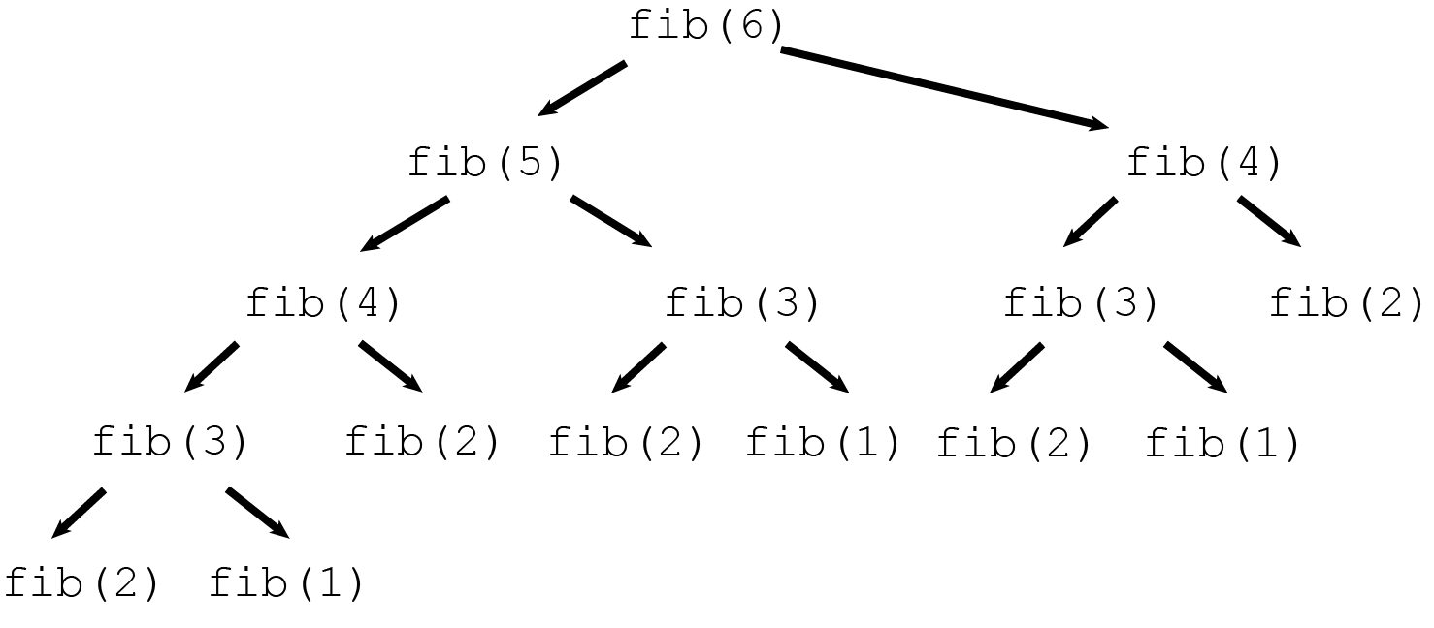

Slide 13
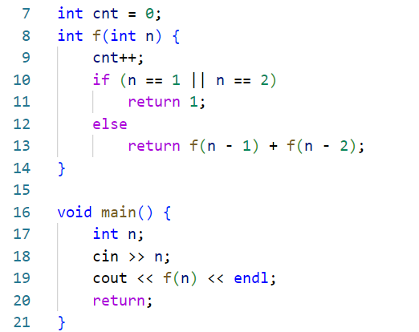
Without DP
Cnt = 1664079 when n = 30

Slide 15
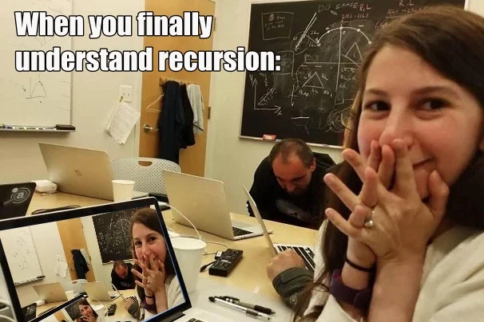

Slide 16
Dynamic Programming

Slide 17
Why Dynamic Programming

Slide 18
Need of DP
Lets understand this form a problem
Find nth Fibonacci number
F(n) = F (n-1) + F(n-2)
F(1) = F(2) = 1

Slide 20
Overlapping subproblems?

Slide 21
Memoization

Slide 22
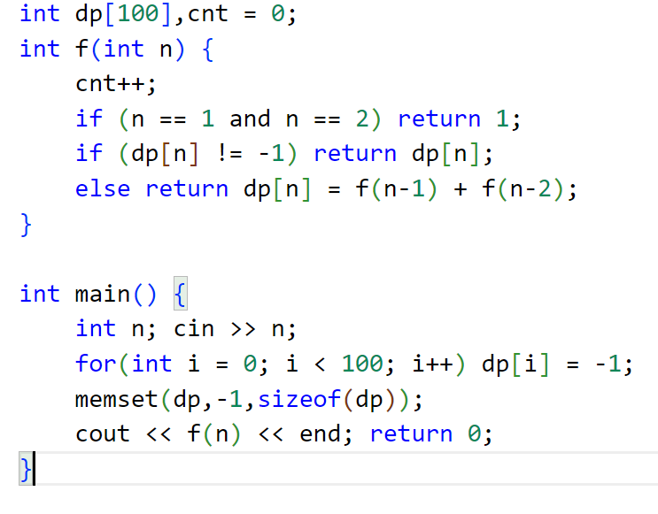
With DP
Cnt = 57 when n = 30

Slide 23
Important Terminology
State: A subproblem that we want to solve. The subproblem may be complex or easy to solve but the final aim is to solve the final problem which may be defined by a relation between the smaller subproblems. Represented with some parameters.
Transition: Calculating the answer for a state (subproblem) by using the answers of other smaller states (subproblems). Represented as a relation b/w states.

Slide 24
Minimizing coins
Consider a money system consisting of n coins. Each coin has a positive integer value. Your task is to produce a sum of money x using the available coins in such a way that the number of coins is minimal.
For example, if the coins are {1,5,7} {1,5,7} and the desired sum is 11, an optimal solution is 5+5+1 which requires 3 coins.

Slide 25
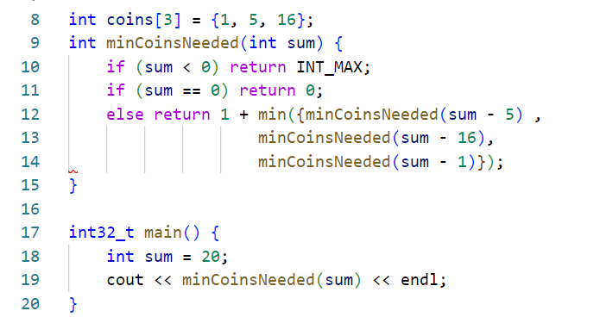
Minimizing Coins

Slide 26
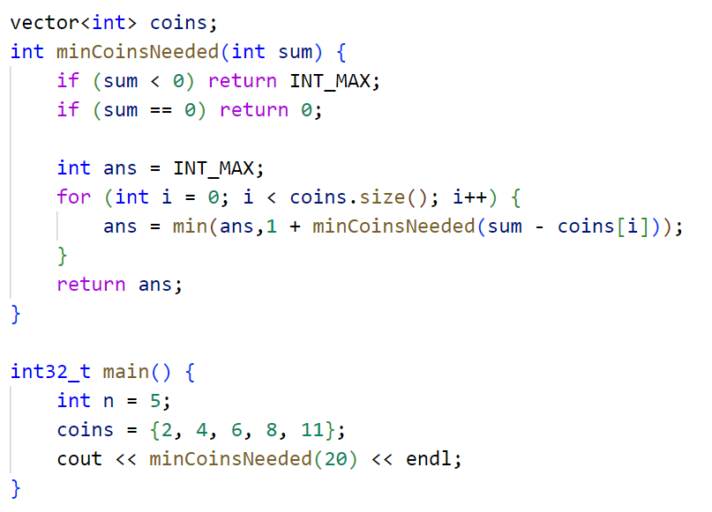
Minimizing Coins

Slide 27
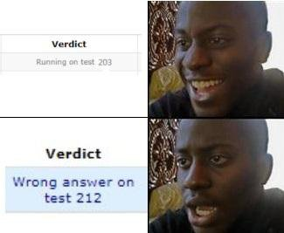

Slide 28
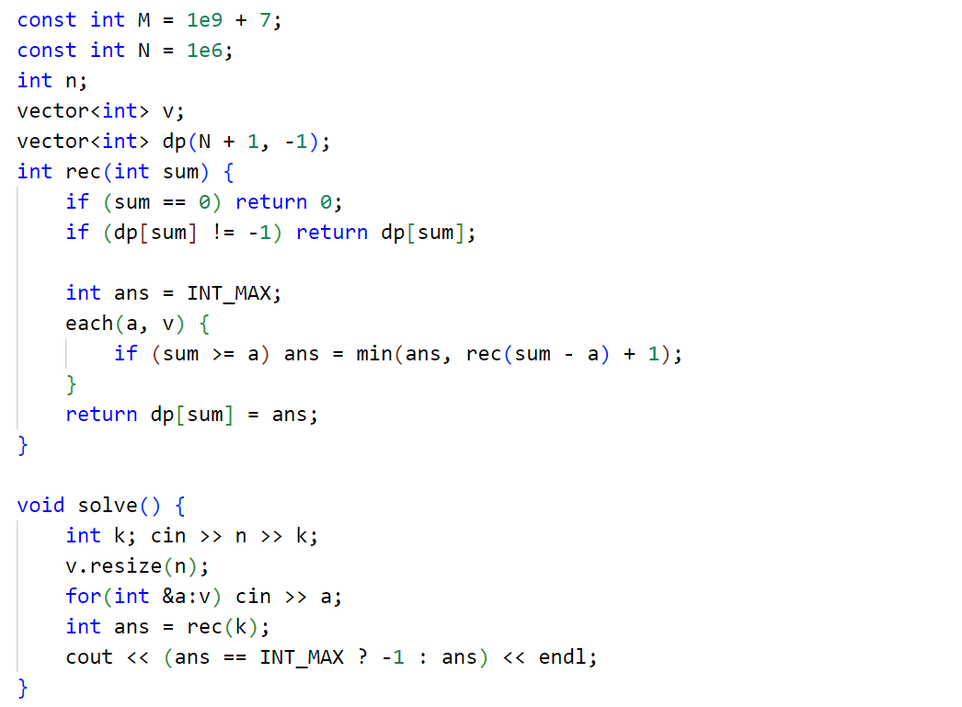
Dp with memoization

Slide 29
Next steps
Assignment 1
Link
Assignment 2
Link
Assignment 3
Link

